Slide 1
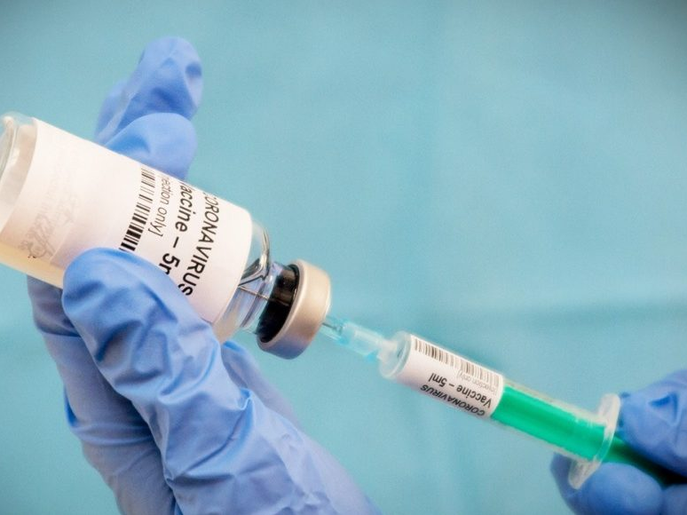
Johnson & Johnson
Assignment companies
Eline Verbiest
Ilani Defryn

Slide 2
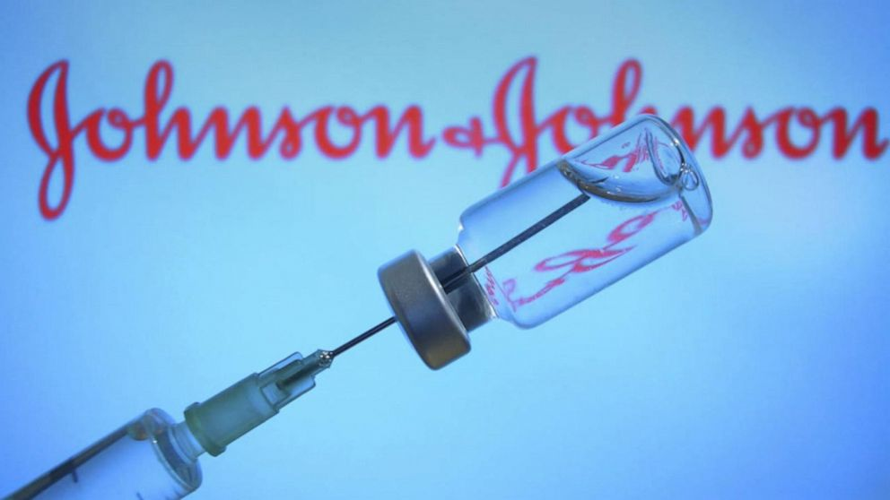
Table of contents
Basic information
List of sources
Innovation
Successfull?
Opinion on quote
Motivation?

Slide 3

Basic information
Johnson & Johnson
1886
New Jersey
International

Slide 4
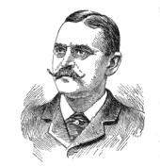
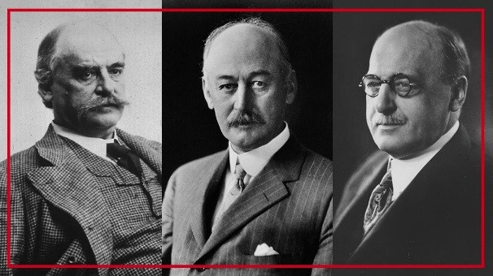
Basic information
History
Robert Wood Johnson and George Seabury
James Wood Johnson and Edward Mead Johnson
First product
1961

Slide 5

Video
https://youtu.be/d-DDHaxYLgA

Slide 6
Table
year | revenue | Net result | employees
2005 | 50 514 | 10 060 | 115 600
2006 | 53 324 | 11 053 | 122 200
2007 | 61 095 | 10 576 | 119 200
2008 | 63 747 | 12 949 | 118 700
2009 | 61 897 | 12 266 | 115 500
2010 | 61 587 | 13 334 | 114 000
2011 | 65 030 | 9 672 | 117 900
2012 | 67 224 | 10 853 | 127 600
2013 | 71 312 | 13 831 | 128 100
2014 | 74 331 | 16 323 | 126 500
2015 | 70 074 | 15 409 | 127 100
2016 | 71 890 | 16 540 | 126 400
2017 | 76 450 | 1 300 | 155 000
2018 | 81 581 | 15 297 | 134 000
2019 | 82 059 | 15 119 | 132 000

Slide 7
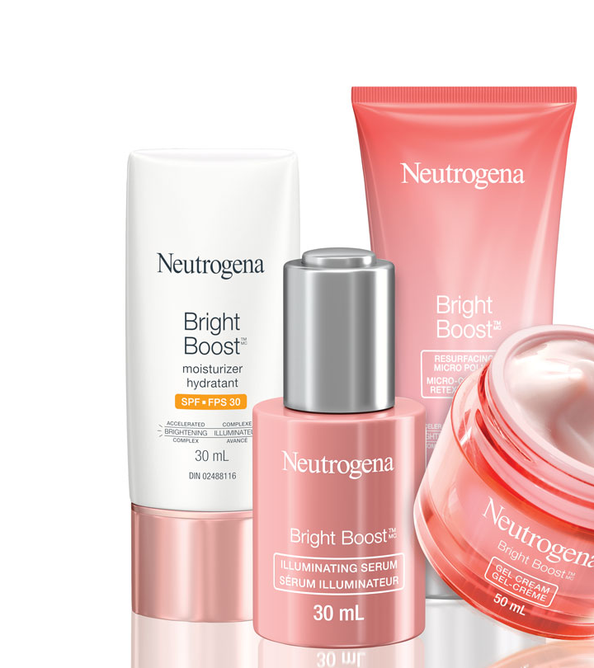
Basic information
Products
Self-care products
Skin health
Essential health

Slide 8
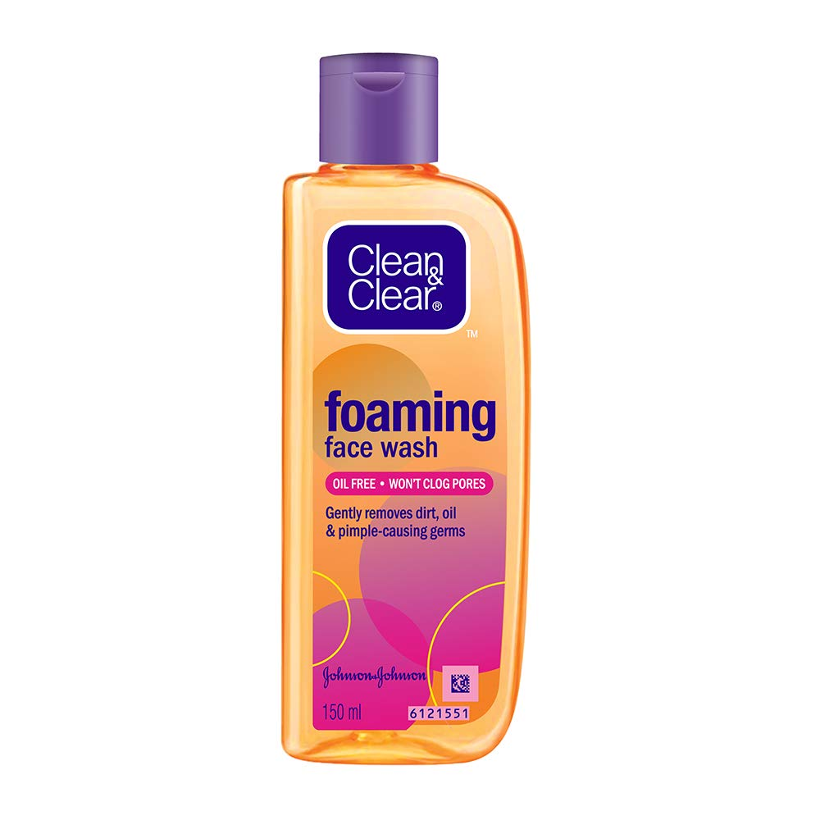
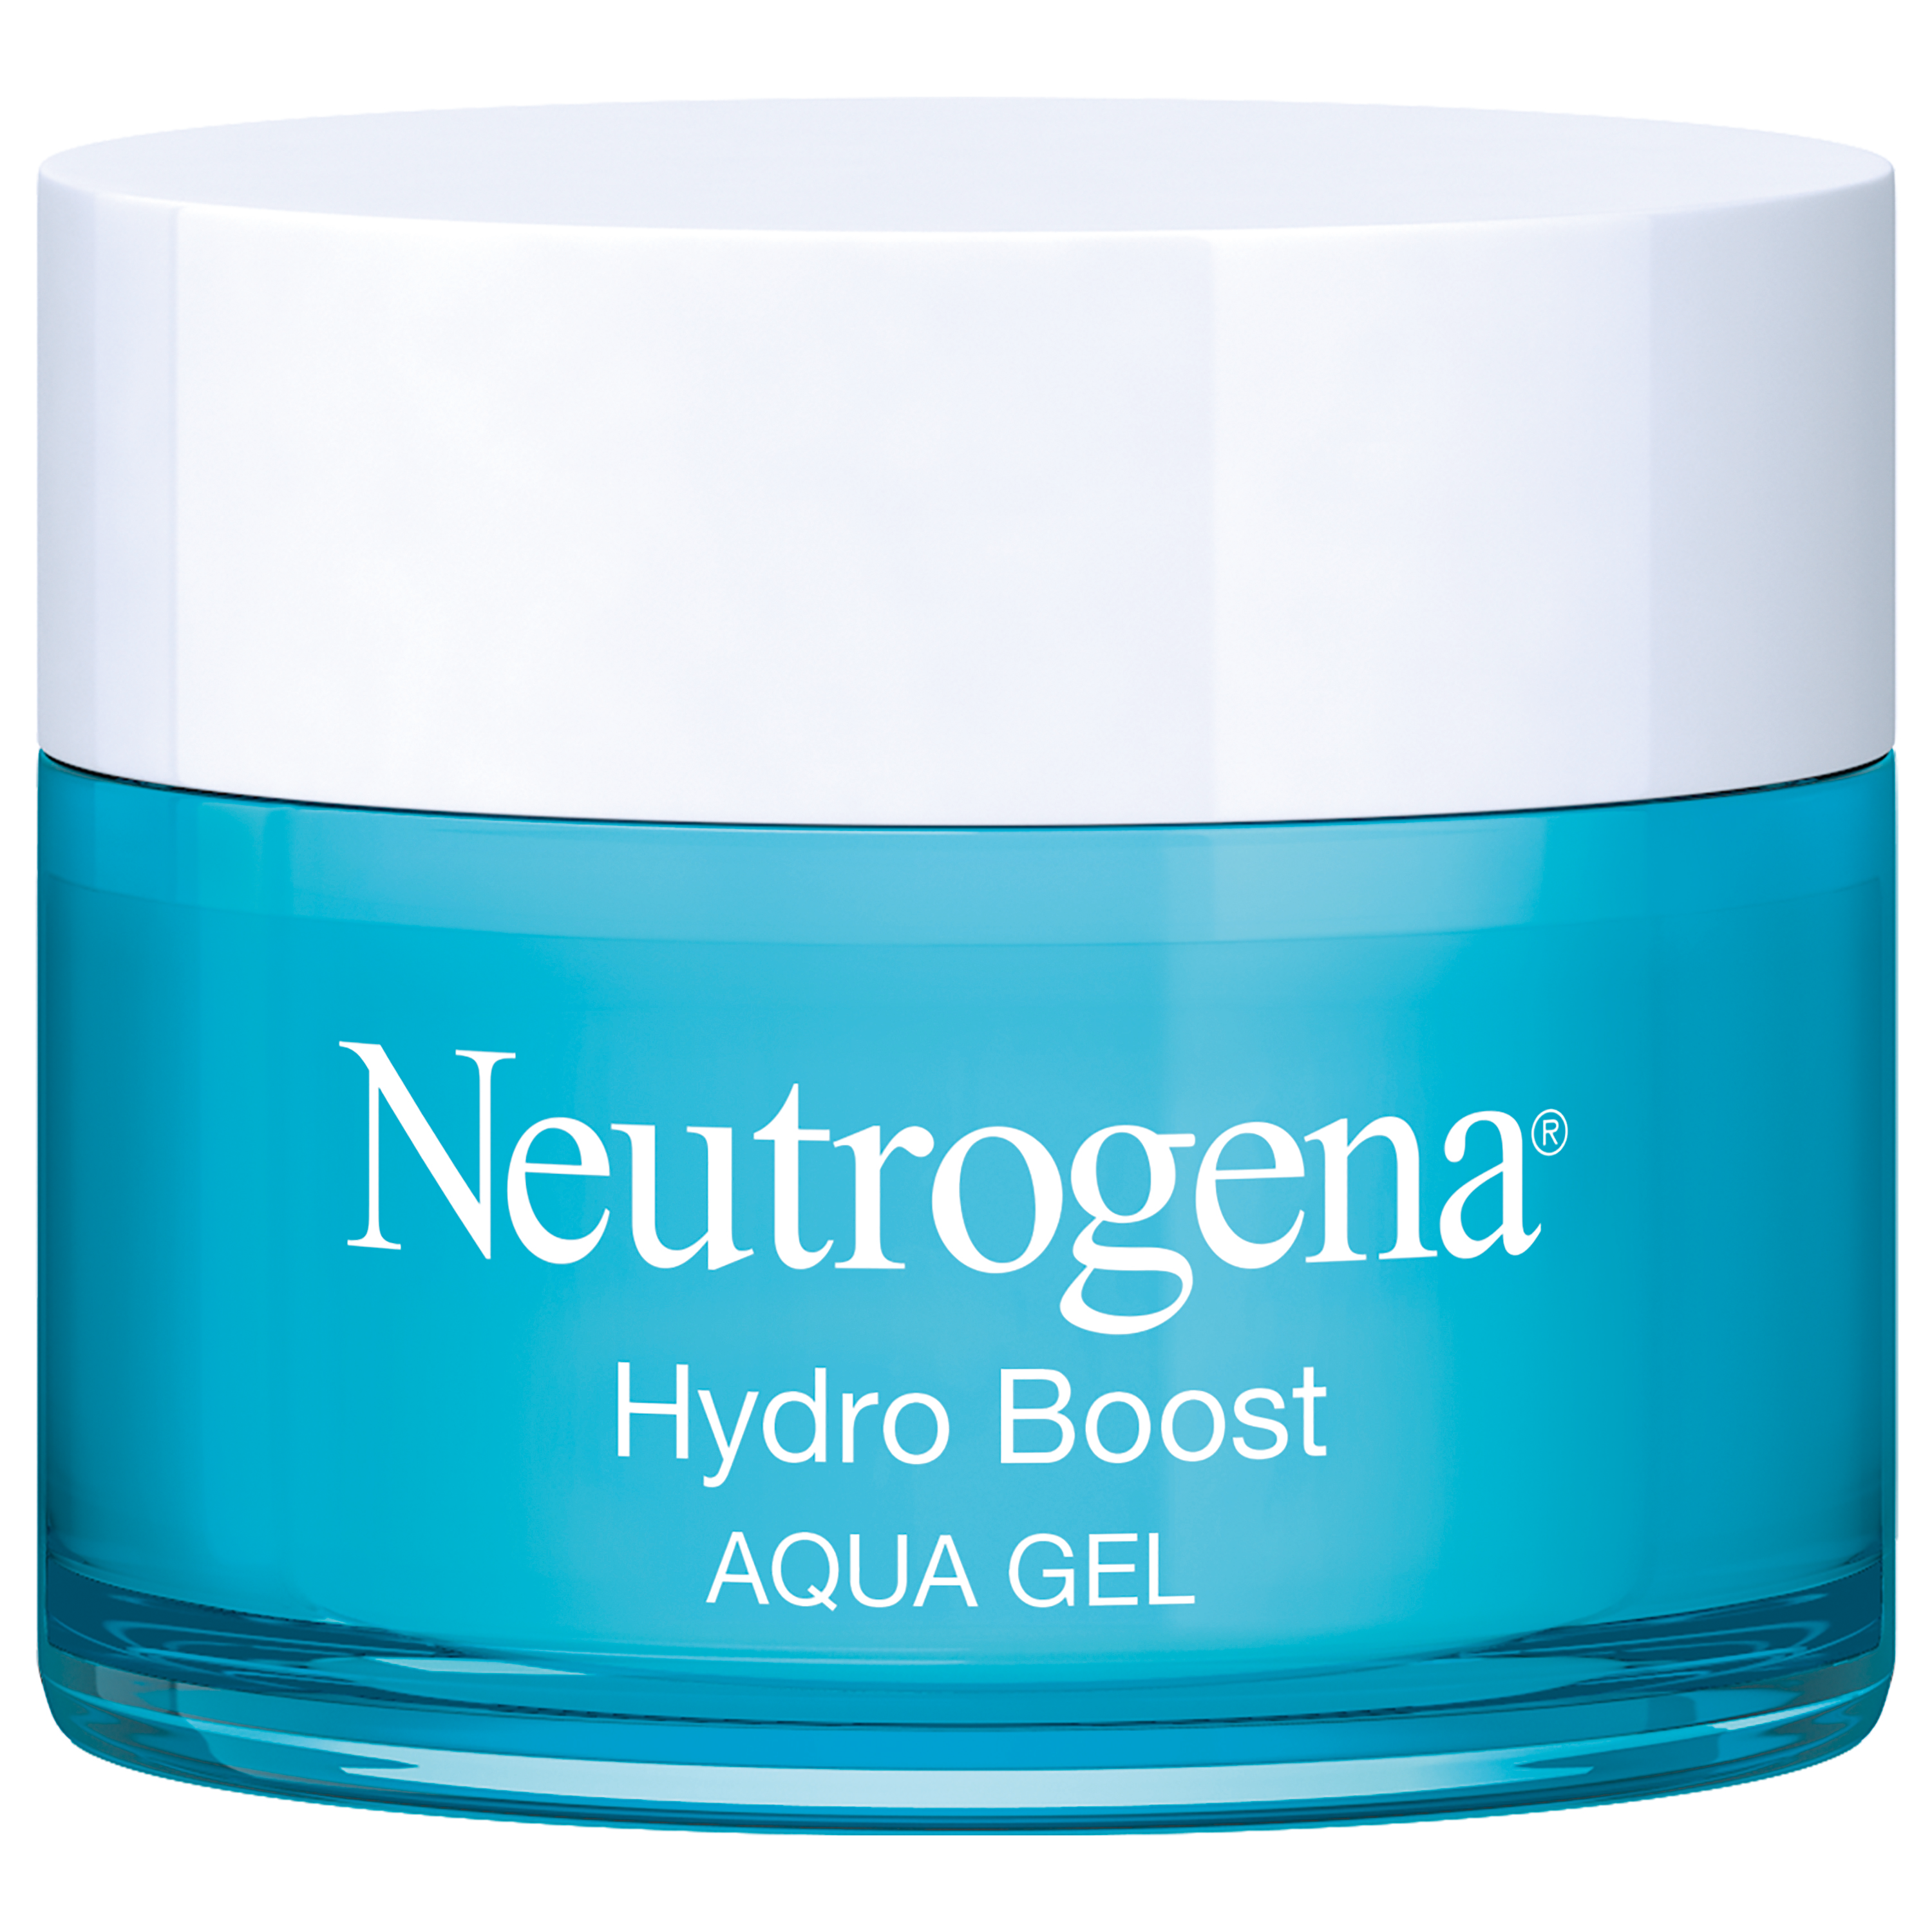
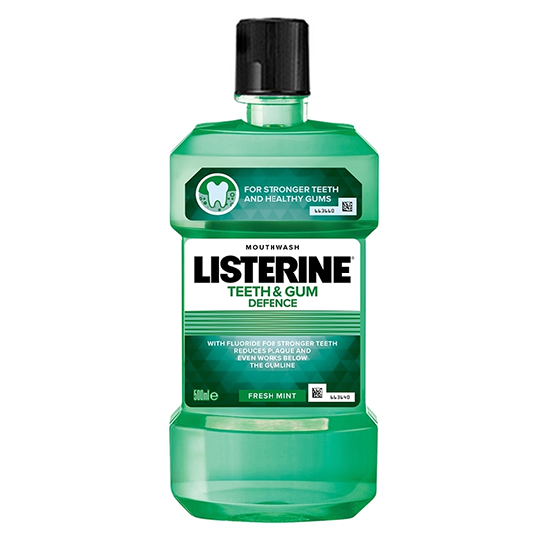
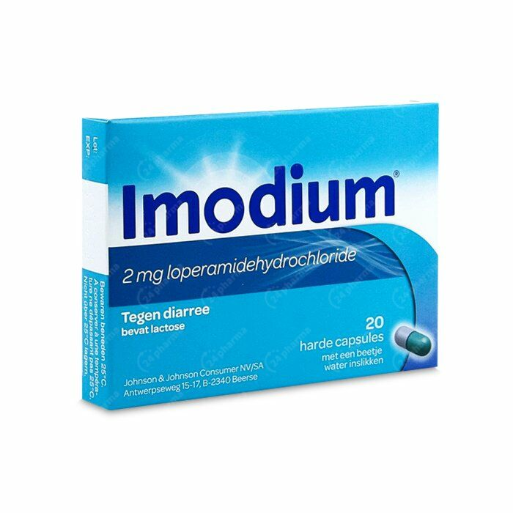
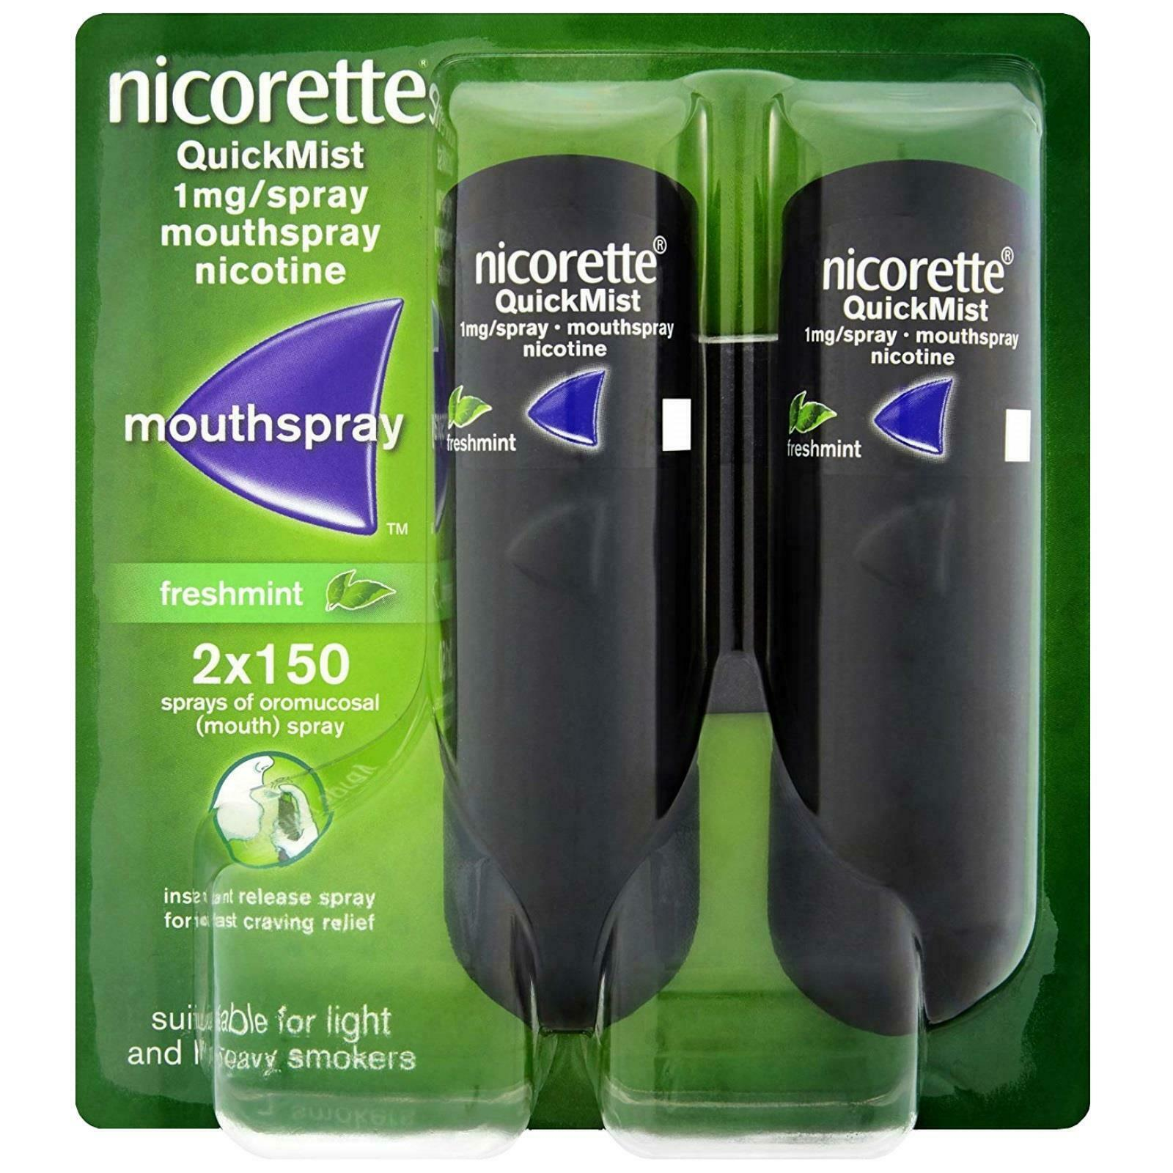
Famous brands

Slide 9
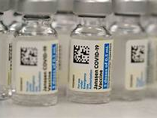
Sources
https://nl.wikipedia.org/wiki/Johnson_%26_Johnson
https://www.jnj.com/
https://craft.co/johnson-johnson
https://www.demorgen.be/nieuws/vs-zien-meer-gevallen-van-bijwerkingen-j-j-vaccin-dan-verwacht-vaccinatiecampagne-gaat-verder~bd4b2263/
https://www.vrt.be/vrtnws/nl/2021/01/29/hoe-goed-werkt-het-vaccin-van-johnson-johnson-precies/

Slide 10

Innovation
New innovation
Vaccine

Slide 11
Successfully?
Covid 19
Competitors
Which variants?

Slide 12

Successfully
Negative effects
Blood clot
Young women
Belgium

Slide 13

Opinion on quote

Slide 14

Motivation

Slide 15

Thank you for listening!
Eline Verbiest
Ilani Defryn

