Slide 1

Why is English a world language?
Ilani Defryn
5EMb

Slide 2
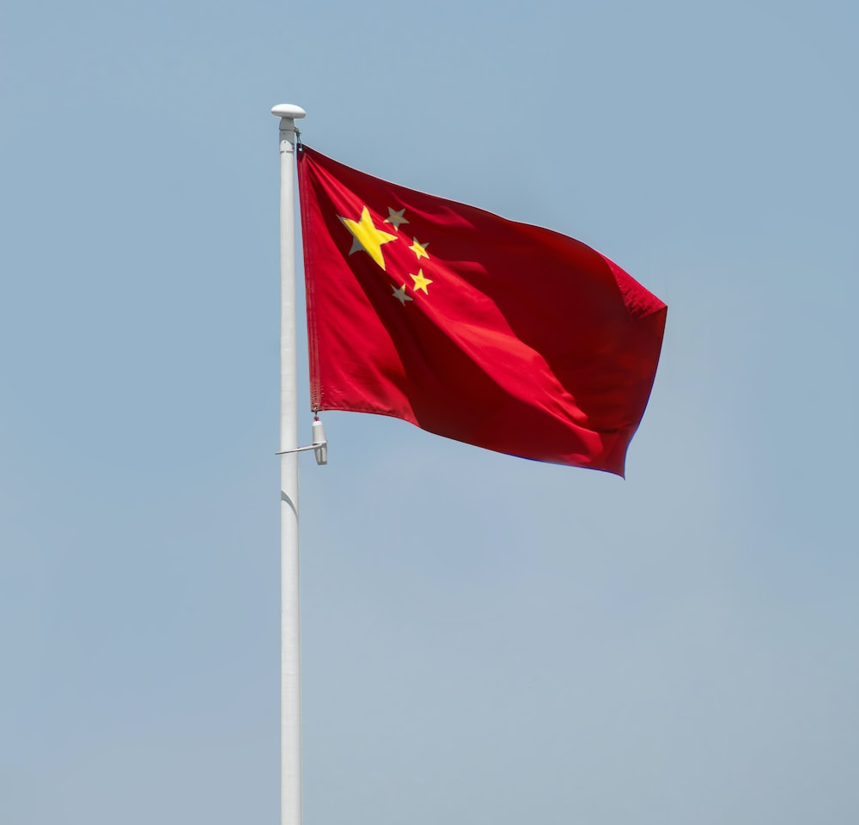

1,412 billion
331,9 million

Slide 3
TABLE OF CONTENTS
01
05
02
06
03
Why is English a world language?
The influence of English on other languages.
English as an official language in many countries.
The disadvantages of Basic English.
Amount of people that speak English globally.
07
Why is speaking all the same language not a good idea?

Slide 4


Sources
Mother Tongue
Hub scuola

Slide 5

O1
Why is English a world language?

Slide 6




Why is English a world language?
Politics, economics & technology
Science
Business
Media
School

Slide 7

02
How does it come that English is an official language in so many countries.

Slide 8
—Bill Bryson, p.176
“No other language than English is spoken as an official language in more countries”

Slide 10
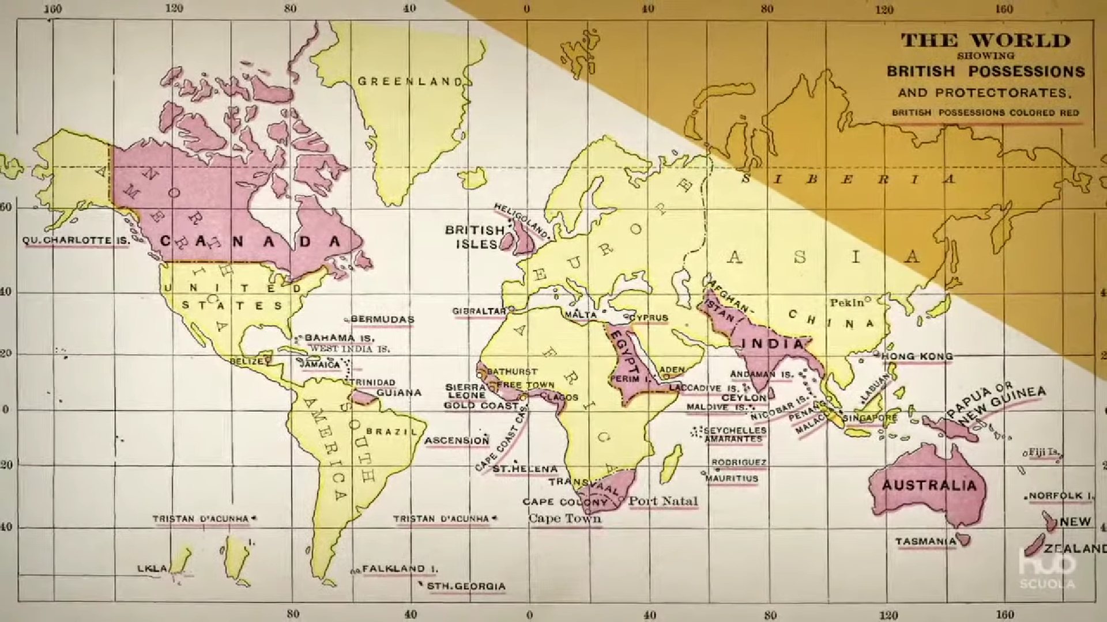

Slide 11
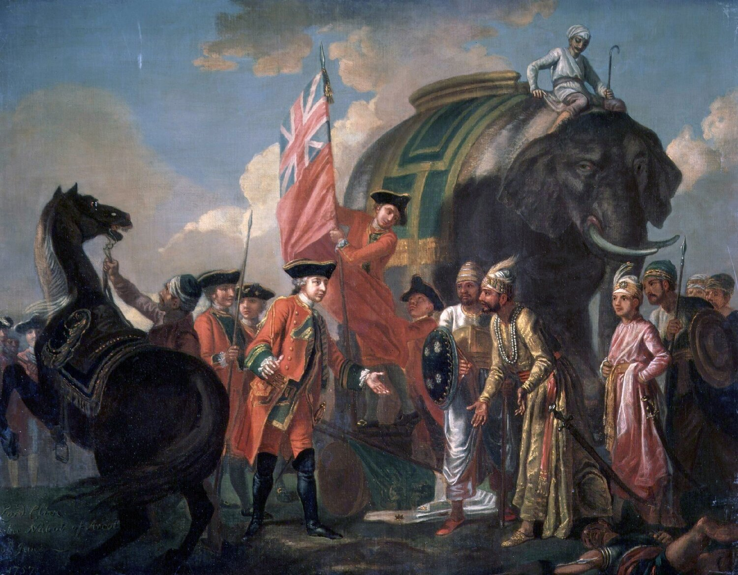
English a second language.
The colonisation of India
700 million
40 or 50 million

Slide 12

O3
Why is it hard to say how many people globally speak English?

Slide 13
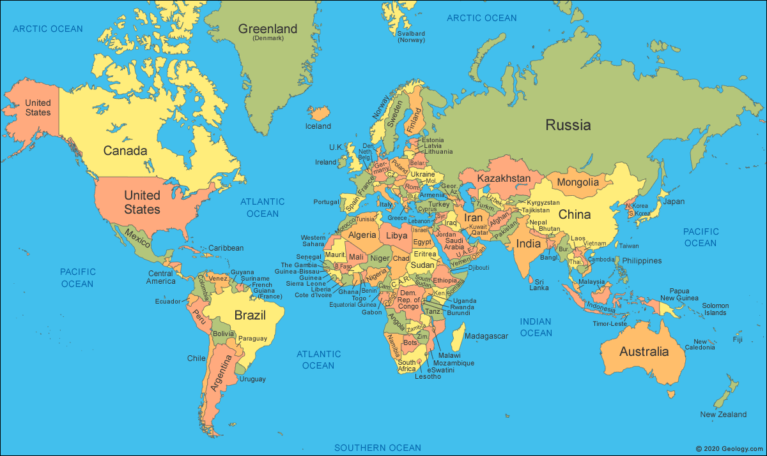
Why is it hard to say how many people globally speak English?
Not everyone speaks English
Something like English
Krio in Sierra Leone
Neo- Melanesian in Papua New Guinea
Thinking that they speak English

Slide 14

O4
What is the influence of English on other languages?

Slide 15
Influence on other languages.
Sweden
Ukraine
Japan
Plural -s
-or, -ar or -er
A little twist
Herkot -> haircut
Native language
Erebeta ->
Bata ->
Made up words
Salaryman -> employee
elevator
butter

Slide 16
Influence on other languages.
France
Belgium and Netherlands
Defenders
Chewing gum -> pâte à mâcher
Jet airplane -> avion à reaction
Own language
Books, television …

Slide 17
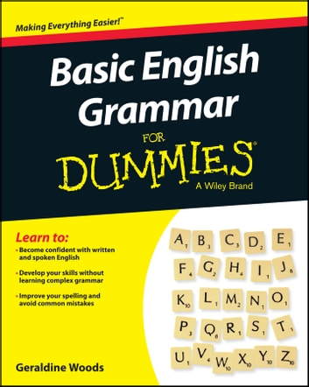
05
What are the disadvantages of Basic English ?

Slide 18
The disadvantages of Basic English.
Simple messages
No idioms, morphology, syntax …
Difficult to describe

Slide 19

O6
Why is speaking all the same language not a good idea?

Slide 20

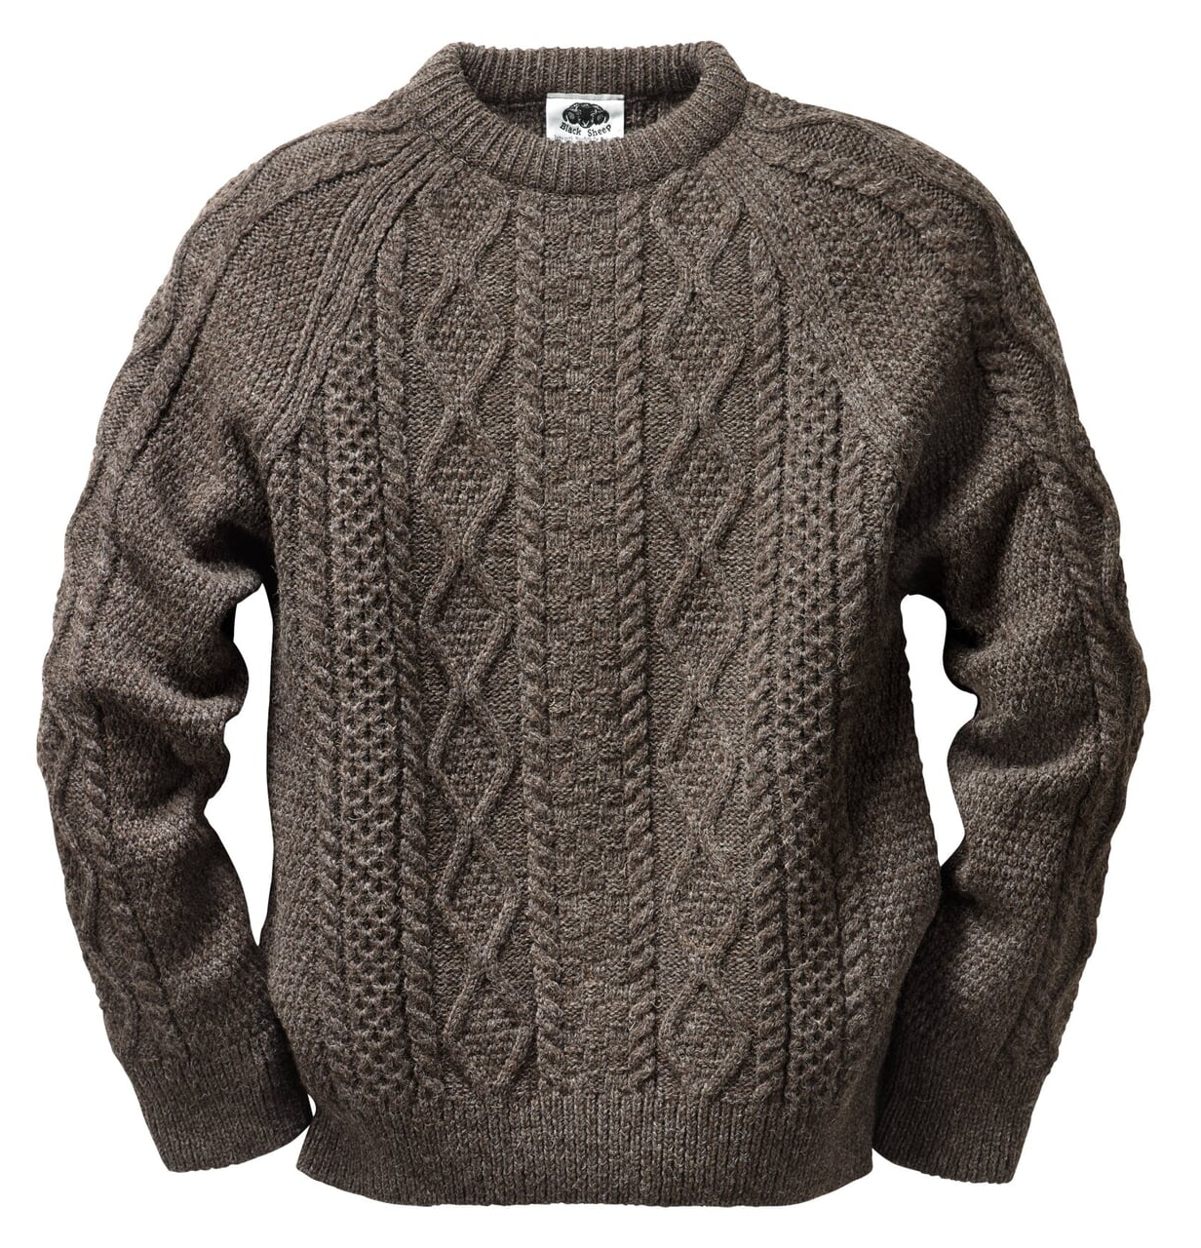
Why is speaking all the same language not a good idea?
English
Italian translation

Slide 21
Conclusion
Universal language
Official language
Great influence
Not 1 type of English
Don’t speak the same language

Slide 22
Are there any questions?
Thank you for lisening.

Slide 23
RESOURCES
Bryson, B. (2009). Mother tongue: The story of the English language. Penguin Books.
Hub Scuola. (2019, July 12). English, a global language [Video]. YouTube. https://www.youtube.com/watch?v=XLYtd7Qivr0

