Slide 1
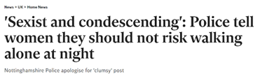

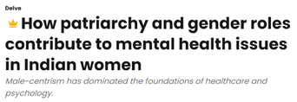





Slide 2

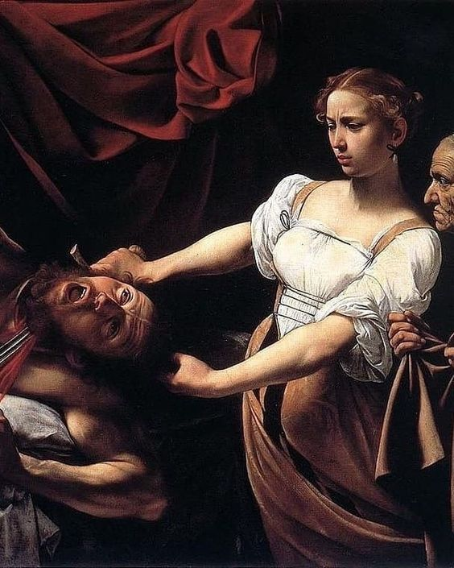
HOW DOES FEMALE RAGE IN LITERATURE EMPOWER WOMEN?
Ilani Defryn, 6EMb

Slide 3
HOW DOES FEMALE RAGE IN LITERATURE EMPOWER WOMEN?
Ilani Defryn, 6EMb

Slide 4
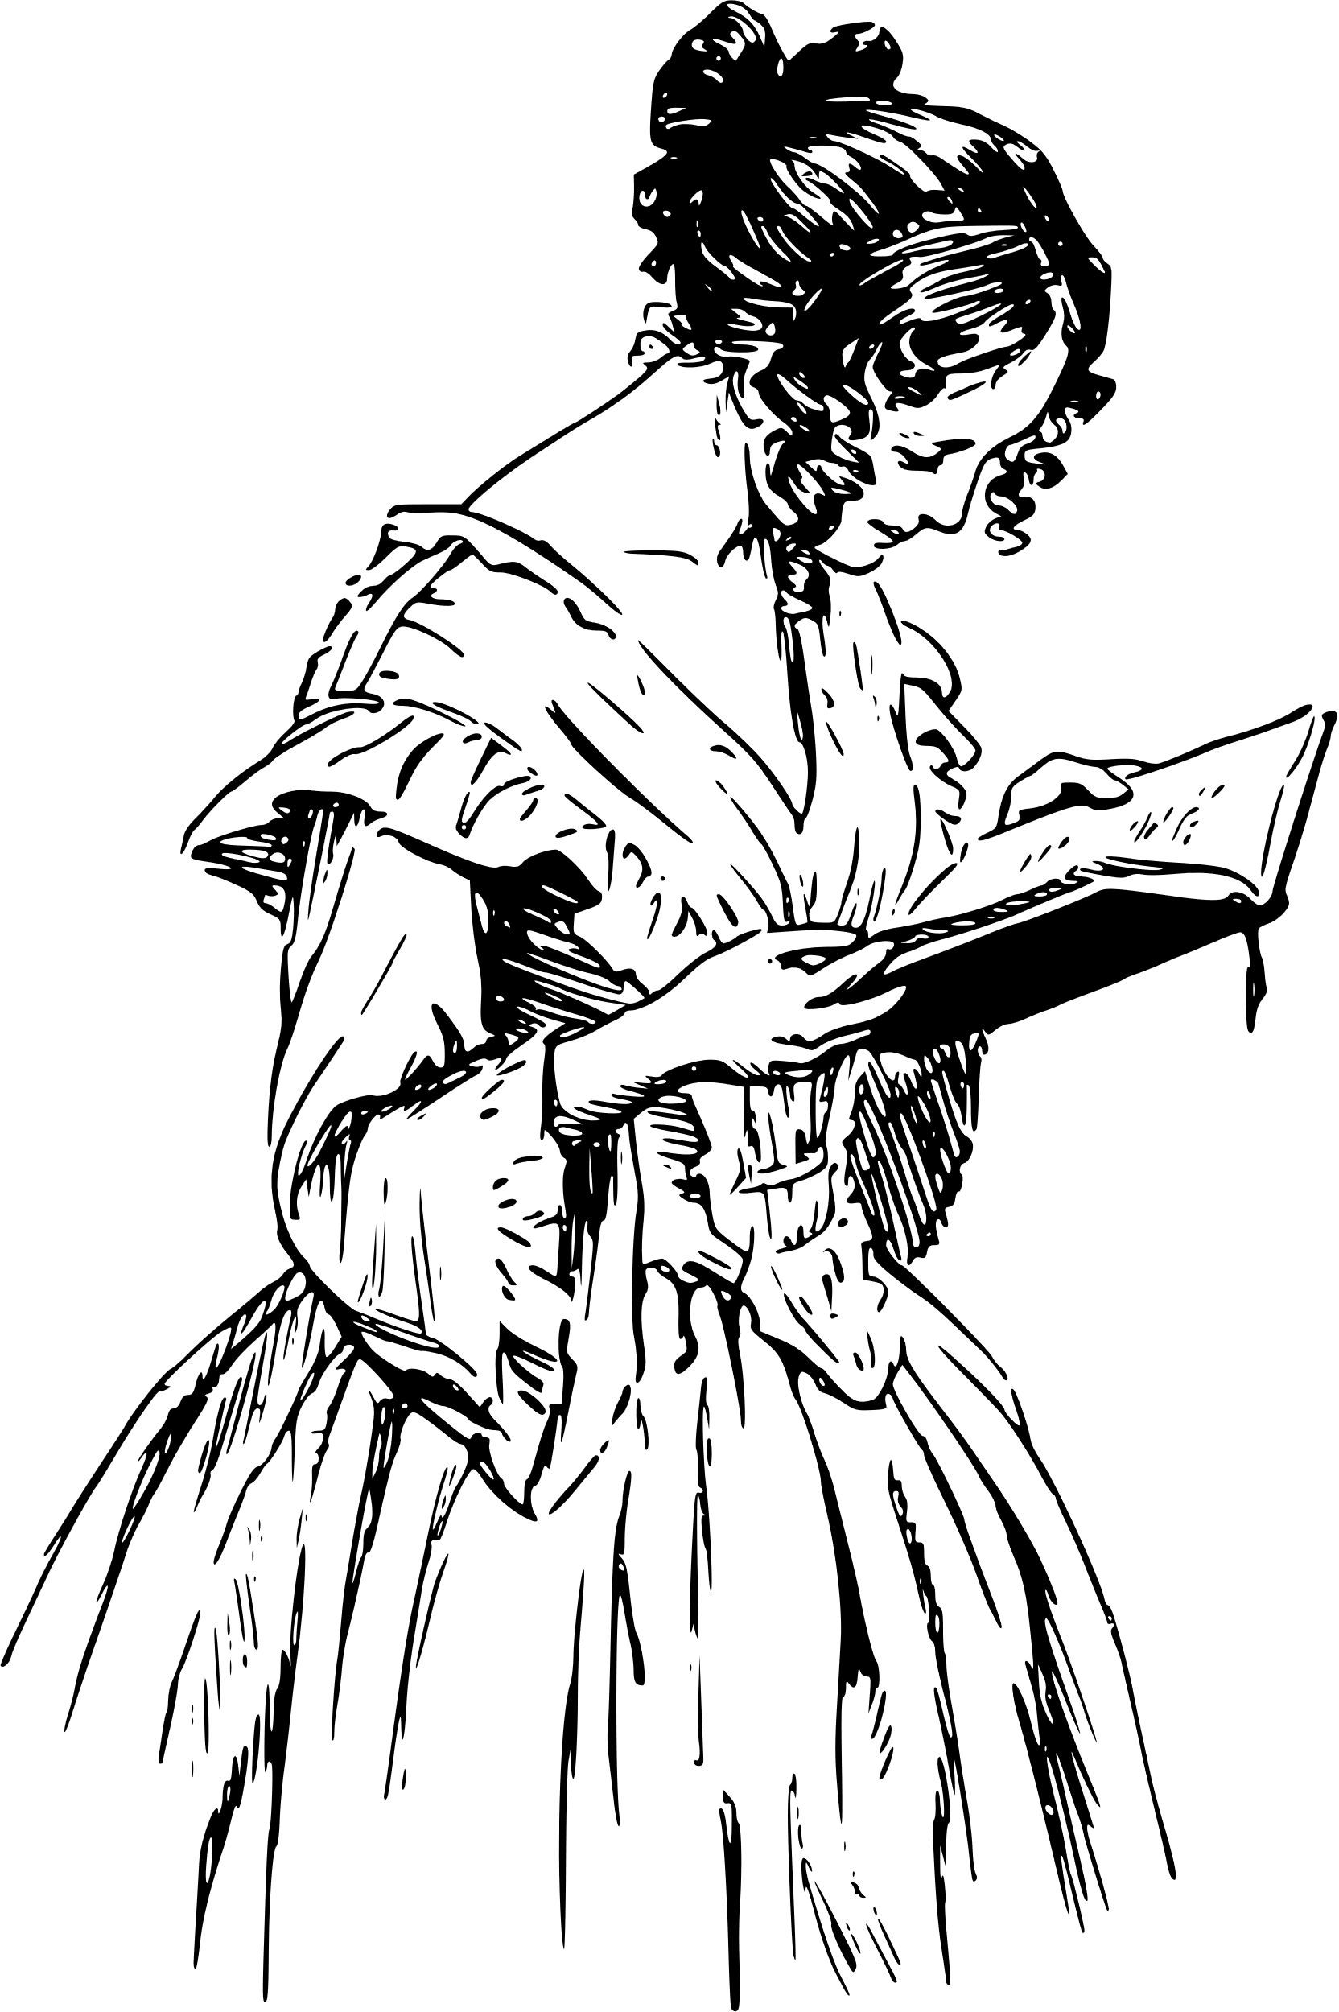
Table of contents:
  Causes:
    Male patriarchy
      Condescension
      Neglect
      Rejection
  Evolution of female rage in literature:
    6 case studies
  Differences and similarities between masculine and feminine
female rage
  How does fema﻿le rage empower women?
    Link with case studies
  Why is it important that we keep writing about women’s anger?
    Link with up- to- date examples

Slide 5
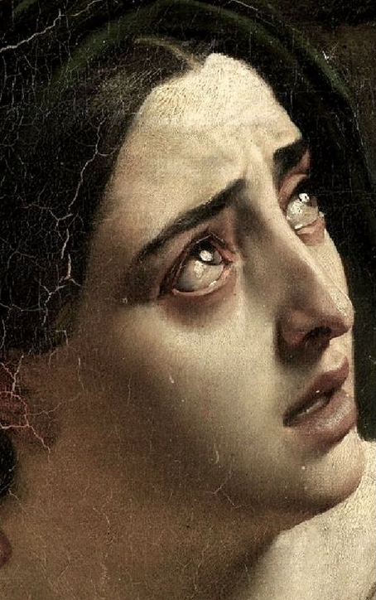
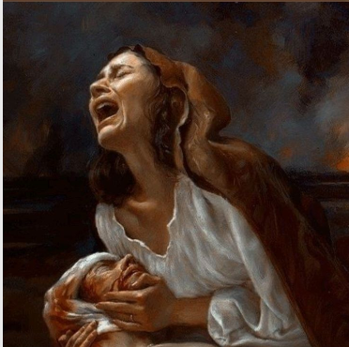
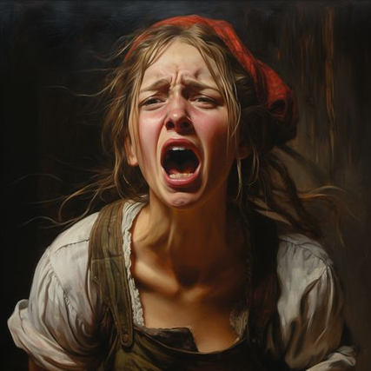
Causes of female rage:
Male patriarchy
Condescension
Neglect
Rejection

Slide 6
Evolution of female rage in literature

Slide 7
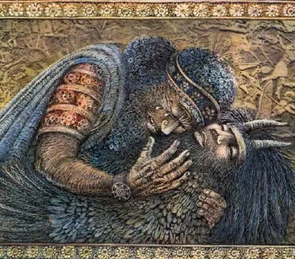
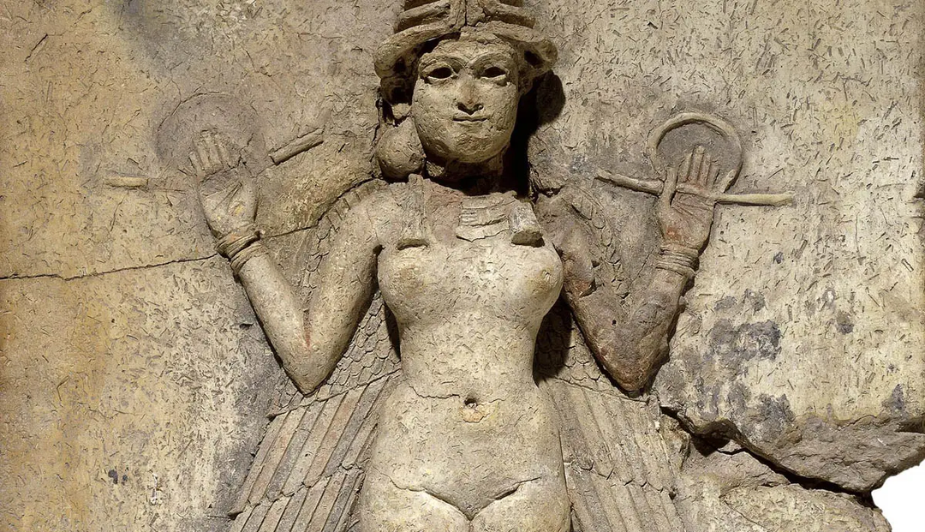
Ancient Near East (3500BC-
800 BC):
The epic of Gilgamesh - Sîn-lēqi-unninni
Characters:
  Enkidu
  Ishtar
Cause:
  Rejection
    Gilgamesh rejects her advances
    Flight-or-fight response
Female character:
  Perfection = stereotypical
    Beautiful, seductive, sensual
  Vengeful woman
    Bull from heaven
  Tantrums

Slide 8
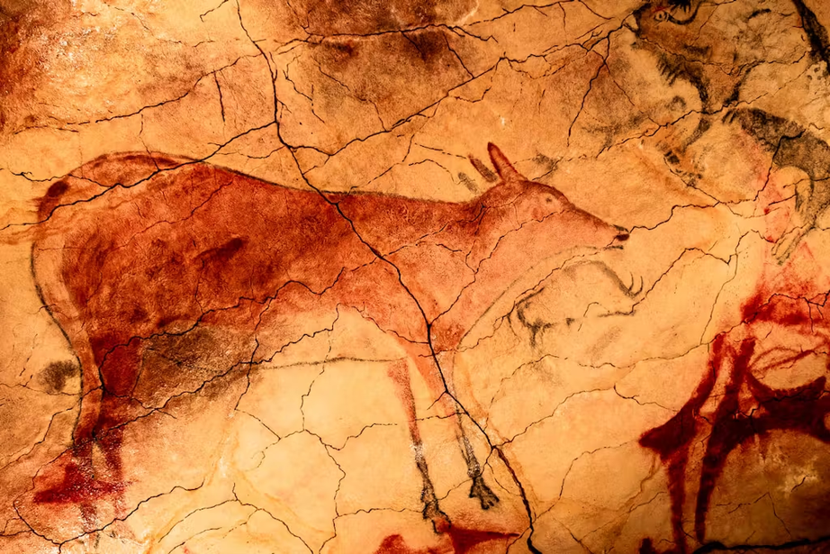
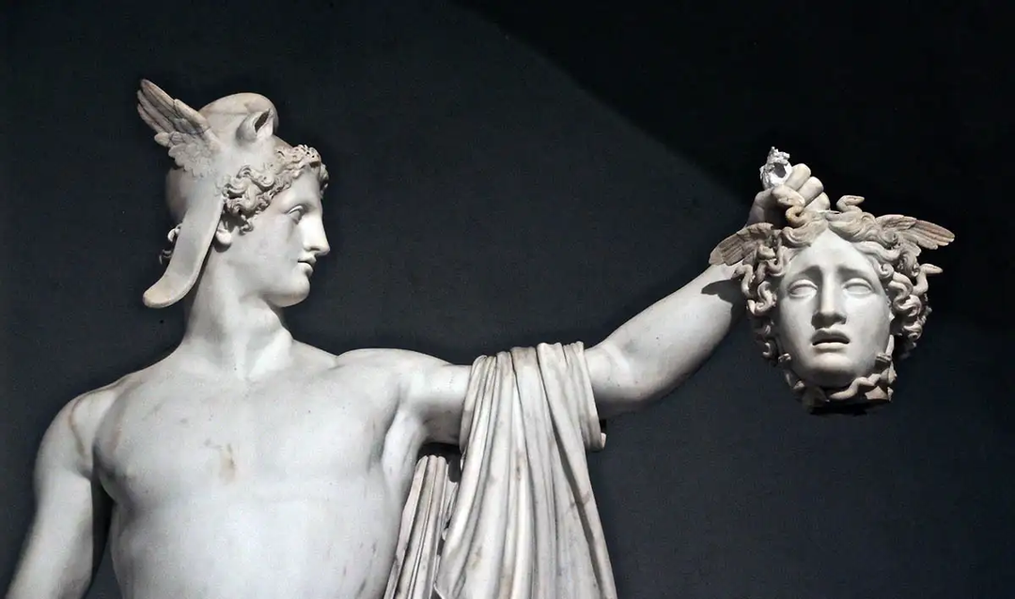
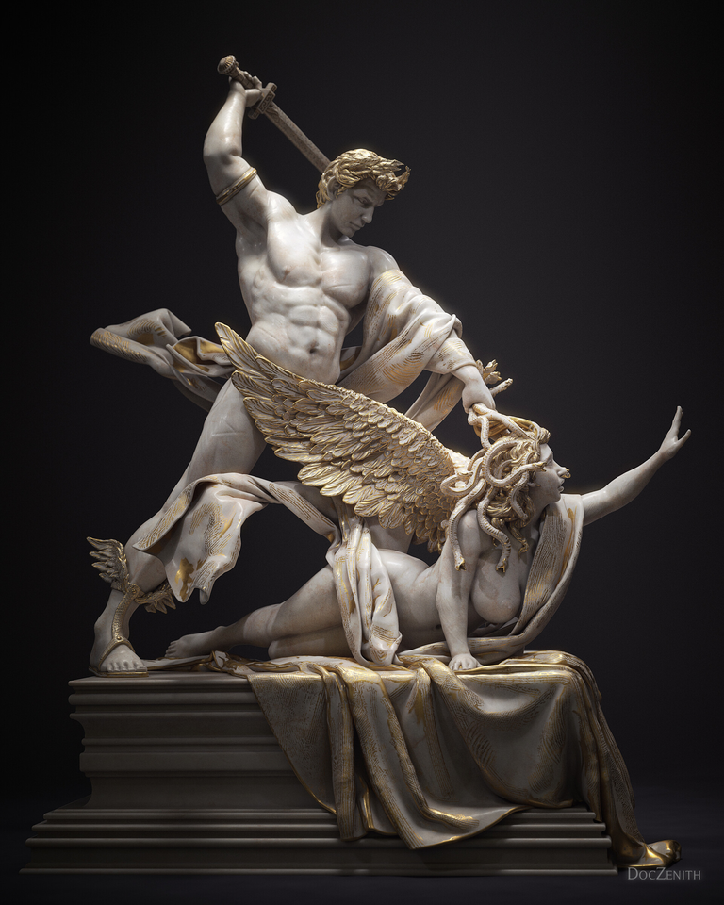
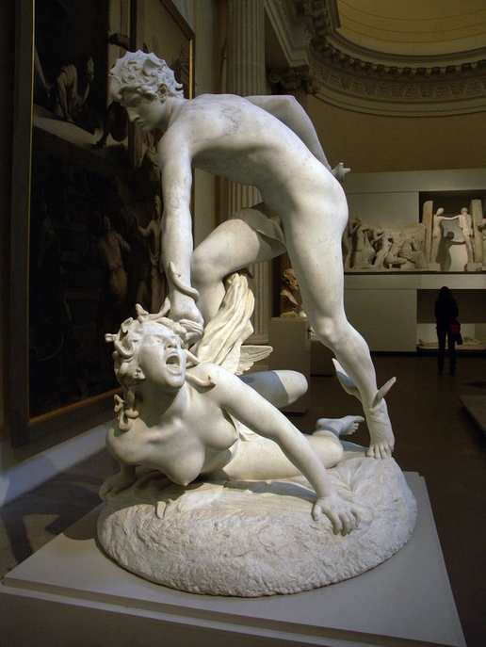
Classical antiquity (800BC- 476):
Medusa - Hesiod
Characters:
  Athena
  Poseidon
  Perseus
Cause:
  Sexual assault
    Rape
  Rejection by Athena
    Victim blaming
Female character:
  Prime of life
    Gorgeous, flamboyant, young
  Human → dangerous monster

Slide 9
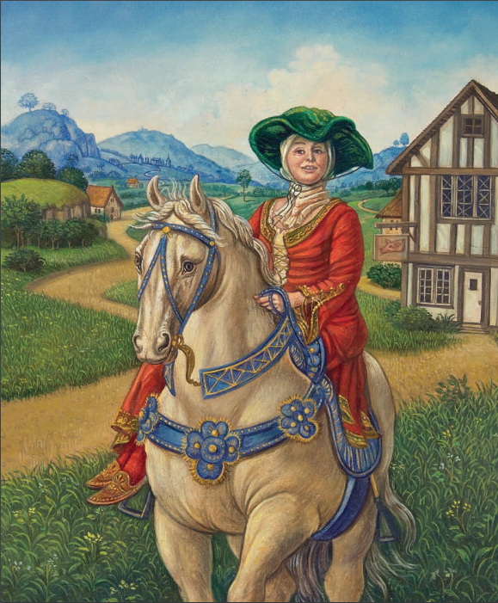
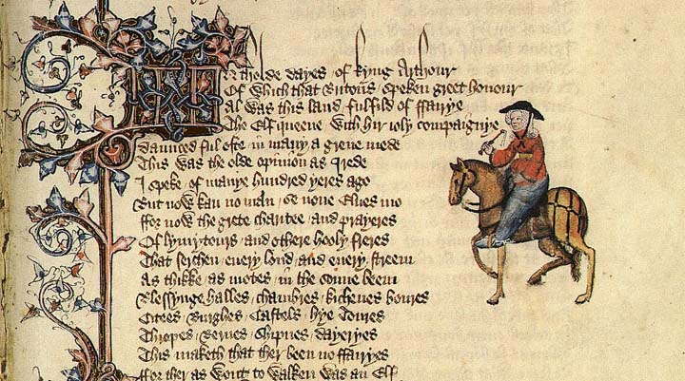
Middle Ages (476- 1450):
The Wife of Bath’s Tale - Geoffrey Chaucer
Characters:
  Alisoun
Cause:
  Male patriarchy
    5 marriages
      Abuse
Female character:
  ≠ stereotypical
  Unconventional
    Against societal expectations
    Resisting male dominance
  Dominant
    Power

Slide 10
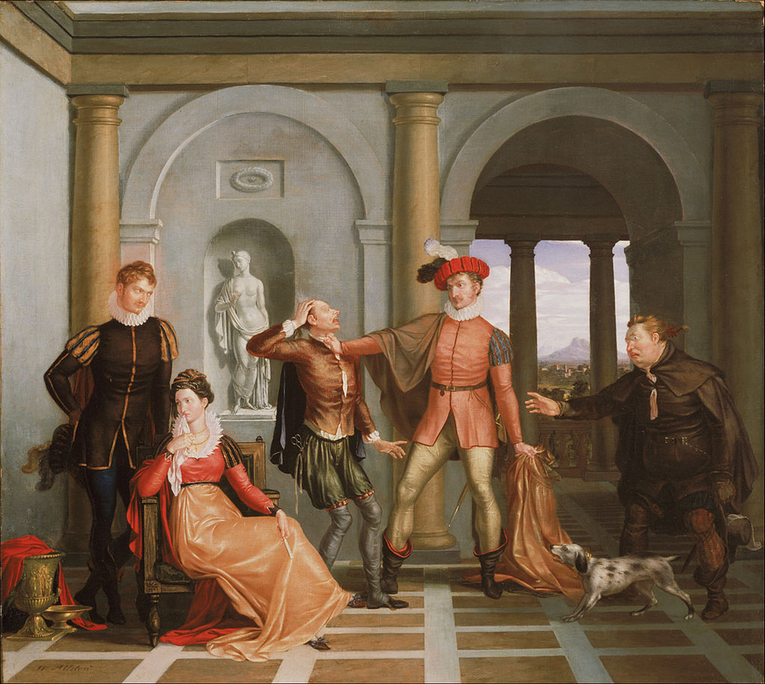
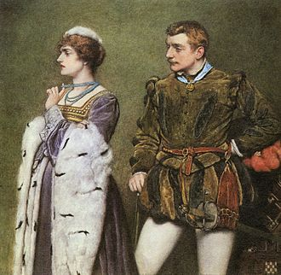
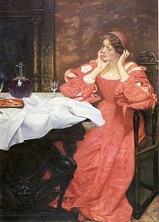
Early modern times (1450- 1750):
The taming of the shrew - William Shakespeare
Characters:
  Katherine
  Bianca
  Petruchio
Cause:
  Parental influence
  Male patriarchy
Female character:
  Headstrong, sarcastic, disobedient
  Doesn’t fit society’s norms
  Tamed by her husband

Slide 11

Masculine female rage:
  Social attitude:
    Unacceptable to express anger
    Not allowed to cause conflict
  Female character:
    Crazy and irrational lunatics
    Ishtar = revengeful
    Medusa = monster
    Katherine
      Change yourself
    Villains
  Female rage:
    Aggresive way
      Alisoun: gaining power
      Ishtar: killing Enkidu
    The pure danger
    Female rage must be stopped
      The taming of the shrew

Slide 12
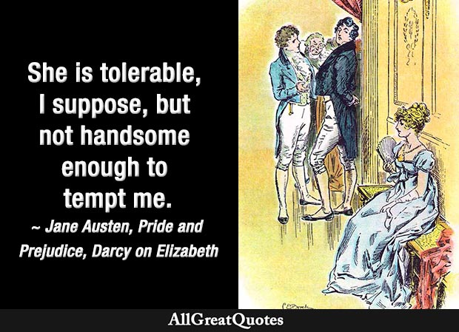
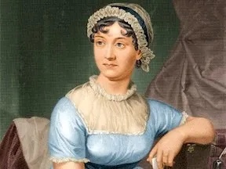
Modern times (1750- 1945):
Pride & Prejudice - Jane Austen
Characters:
  Elizabeth Bennet
  Mr. Darcy
Cause:
  Male patriarchy
    Marrying off
    Woman = baby machine
  Condenscending
    Arrogance of Mr. Darcy
Female character:
  Intelligent
    Sharp tongue, importance of her own happiness, opinion
(Austen, P.13)

Slide 13

Present day (1945-…)
The girls -Emma Cline
Characters:
  Evie Boyd
  Russel
Cause:
  Societal norms and expectations
  Neglect
    Parents’ divorce
    Flight-or-fight response
  Misogyny
    Manipulation and abuse
    Flight-or-fight response
Female character:
  Introvert, vulnerable
  Rebel

Slide 14

Feminine female rage:
  Social attitude:
    Woman's anger is more accepted
  Female character:
    Elizabeth = intelligent + stubborn character
      Addressing social ideas
    Evie: neglected + an object
  Female rage:
    ≠ violent
    Subtle
      Elizabeth: sarcastic and ironic remarks
    “I could easily forgive his pride, if he had not mortified mine” (Austen, p.19)
    Evie: fleeing

Slide 15

How does female rage empower women?
  Assertiveness + Boundaries
    Pride & Prejudice: refusing marriage proposals
    Medusa: rejects Poseidon
  Social change
    The girls: social restrictions
  Stereotypes
    The Wife of Bath’s Tale: ≠ stereotypical housewife

Slide 16
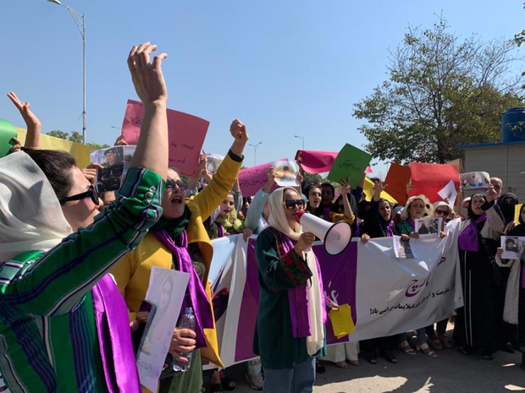

Why is it important that we keep writing about women’s anger?
  Women’s voice
    Share experiences and opinions
    Afghanistan
      Rights
  A safe place
    Better for mental health
    High functioning anxiety
  Reflecting on social and cultural factors → ideal world
  Yousafzai, S. (2023, March 8). On International Women’s Day, Afghan women blast the Taliban and say the world has “neglected us completely.” CBS News. https://www.cbsnews.com/news/international-womens-day-afghanistan-taliban-women-protest-say-world-neglected-us/
  Prateek Sharma, & Prateek Sharma. (2021, May 27). How patriarchy and gender roles contribute to mental health issues in Indian women. The News Minute. https://www.thenewsminute.com/delve/how-patriarchy-and-gender-roles-contribute-mental-health-issues-indian-women-67688

Slide 17
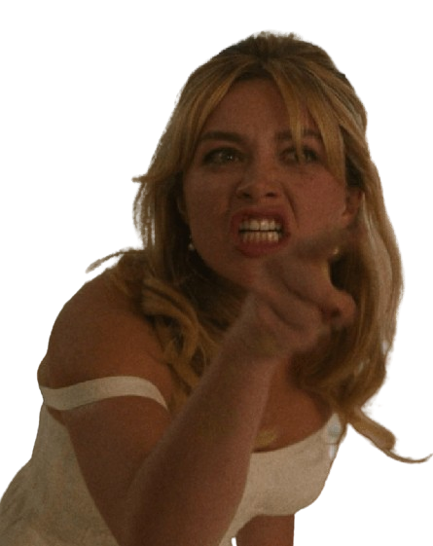
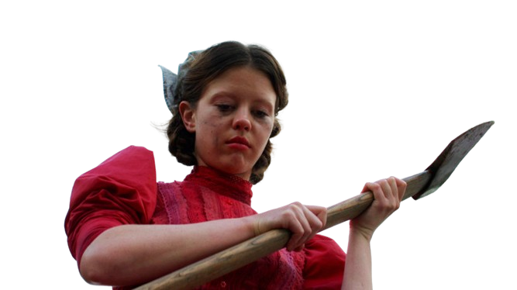
Thank you for your attention.

Slide 18
BIBLIOGRAPHY
  Primary sources:
  Cline, E. (2017). The girls: A Novel. Random House Trade Paperbacks.
  Secondary sources:
  Tidman, Z. (n.d.). “Sexist and condescending”: Police tell women they should not risk walking alone at night | The Independent. The Independent. https://www.independent.co.uk/news/uk/home-news/women-walk-alone-night-risk-nottinghamshire-police-facebook-a9219451.html
  Toronto cop who neglected slain woman’s domestic violence complaint will keep his job. (2023, August 3). CBC. https://www.cbc.ca/news/canada/toronto/daniella-mallia-sang-youb-lee-toronto-police-1.6926828
  Yousafzai, S. (2023, March 8). On International Women’s Day, Afghan women blast the Taliban and say the world has “neglected us completely.” CBS News. https://www.cbsnews.com/news/international-womens-day-afghanistan-taliban-women-protest-say-world-neglected-us/
  Aap. (2023, October 30). Woman jailed 12 years for married lover’s murder. Breaking Australian and World News Headlines - 9News. https://www.9news.com.au/national/woman-jailed-12-years-for-married-lovers-murder/843461a3-dc6d-4f10-a171-118db75d1544

Slide 19
BIBLIOGRAPHY
  Ramdani, N. (2023, January 24). Being a woman in France, it is common to see men act with impunity and get away with sleaze. inews.co.uk. https://inews.co.uk/news/world/woman-france-men-sleaze-2102900
  Prateek Sharma, & Prateek Sharma. (2021, May 27). How patriarchy and gender roles contribute to mental health issues in Indian women. The News Minute. https://www.thenewsminute.com/delve/how-patriarchy-and-gender-roles-contribute-mental-health-issues-indian-women-67688
  Hamburg, U. (2018, September 28). Which roles did women play in the Epic of Gilgamesh? Universität Hamburg. https://www.csmc.uni-hamburg.de/publications/mesopotamia/2018-09-29.html#:~:text=Shamhat%2C%20the%20prostitute%2C%20has%20a,'%20Enkidu%2C%20the%20wild%20man.
  Mehlhorn, D. (2023, May 22). Homophobia: a Modern Sickness - Dmitri Mehlhorn - Medium. Medium. https://medium.com/@DmitriMehlhorn/homophobia-a-modern-sickness-c41763f94bca
  Hamburg, U. (2018, September 28). Which roles did women play in the Epic of Gilgamesh? Universität Hamburg. https://www.csmc.uni-hamburg.de/publications/mesopotamia/2018-09-29.html#:~:text=Shamhat%2C%20the%20prostitute%2C%20has%20a,'%20Enkidu%2C%20the%20wild%20man.

Slide 20
BIBLIOGRAPHY
  Mehlhorn, D. (2023, May 22). Homophobia: a Modern Sickness - Dmitri Mehlhorn - Medium. Medium. https://medium.com/@DmitriMehlhorn/homophobia-a-modern-sickness-c41763f94bca
  BetterHelp Editorial Team. (2024, January 3). Are you wondering, “Why are women so mean with rejection?” Read this. https://www.betterhelp.com/advice/self-esteem/why-are-women-so-mean-when-it-comes-to-rejection/
  SM, M. (2022, January 19). The stigma around female rage — Assembly | Malala Fund. Assembly. https://assembly.malala.org/stories/the-stigma-around-female-rage#:~:text=Patriarchal%20society%20teaches%20us%20to,for%20expressing%20the%20same%20emotions.
  gender bias. (2024, February 9). European Institute for Gender Equality. https://eige.europa.eu/publications-resources/thesaurus/terms/1320?language_content_entity=en#:~:text=Description,men%20in%20rights%20and%20dignity.
  Graham, M. (2023, July 4). Common examples of how patriarchy shows up in our lives. Let’s talk. https://www.linkedin.com/pulse/common-examples-how-patriarchy-shows-up-our-lives-lets-maddie-graham
  Nash, C. J. (2009). Patriarchy. In Elsevier eBooks (pp. 102–107). https://doi.org/10.1016/b978-008044910-4.00982-2
  Wikipedia-bijdragers. (2022, December 22). Vecht-of-vluchtreactie. Wikipedia. https://nl.wikipedia.org/wiki/Vecht-of-vluchtreactie

Slide 21
BIBLIOGRAPHY
  BetterHelp Editorial Team. (2024b, January 3). Are you wondering, “Why are women so mean with rejection?” Read this. https://www.betterhelp.com/advice/self-esteem/why-are-women-so-mean-when-it-comes-to-rejection/
  neglect. (2024). https://dictionary.cambridge.org/dictionary/english/neglect
  ocondescension.(2024). https://dictionary.cambridge.org/nl/woordenboek/engels/condescension
  Wikipedia-bijdragers. (2023a, July 31). Homerus. Wikipedia. https://nl.wikipedia.org/wiki/Homerus
  Humanities, T. (2019, November 12). Making Medusa and the tale of the snake-haired Gorgon - Talking Humanities. Talking Humanities. https://talkinghumanities.blogs.sas.ac.uk/2019/11/14/making-medusa-and-the-tale-of-the-snake-haired-gorgon/#:~:text=Like%20all%20myths%2C%20the%20story,on%20them%20turn%20to%20stone
  oHesiod’s Theogony: the Gorgon Medusa. (n.d.). https://reflection.eleusinianm.co.uk/explore-the-motifs/snakes-and-dragons/bermondsey/bermondsey_2#:~:text=8th%20century%20BC%2C%20ancient%20Greek,Mount%20Helicon%2C%20Boeotia%2C%20Greece.
  Wikipedia contributors. (2023, November 19). Emma Cline. Wikipedia. https://en.wikipedia.org/wiki/Emma_Cline
  Wikipedia-bijdragers. (2023, December 23). Vrouwelijke woede. Wikipedia. https://nl.wikipedia.org/wiki/Vrouwelijke_woede

Slide 22
BIBLIOGRAPHY
  Empower - Definition, Meaning & Synonyms. (n.d.). In Vocabulary.com. https://www.vocabulary.com/dictionary/empower#:~:text=Empower%20means%20%22give%20power%20or,around%20since%20the%2017th%20century.
  Edwards, S. (2015, September 21). The History of Female Anger. vice.com. https://www.vice.com/en/article/4xke4b/the-history-of-female-anger
  Wikipedia-bijdragers. (2024, January 29). Gilgamesj-Epos. Wikipedia. https://nl.wikipedia.org/wiki/Gilgamesj-epos#Ontstaan_en_ontwikkeling_van_het_epos
  Wikipedia-bijdragers. (2023a, July 27). The Wife of Bath’s Tale. Wikipedia. https://nl.wikipedia.org/wiki/The_Wife_of_Bath%27s_Tae
  aanman, J. (2022, February 12). Het epos van Gilgamesh – De held die bijna onsterfelijk werd. Modern Myths - Popcultuur Voor Avonturiers. https://www.modernmyths.nl/het-epos-van-gilgamesh/
  Wikipedia contributors. (2024, February 8). Gilgamesh. Wikipedia. https://en.wikipedia.org/wiki/Gilgamesh#:~:text=The%20standard%20Akkadian%20Epic%20of,befriends%20the%20wild%20man%20Enkidu.
  Wikipedia contributors. (2023, December 26). The taming of the shrew.Wikipedia. https://en.wikipedia.org/wiki/The_Taming_of_the_Shrew

Slide 23
BIBLIOGRAPHY
  Wikipedia-bijdragers. (2024a, January 28). William Shakespeare. Wikipedia. https://nl.wikipedia.org/wiki/William_Shakespeare
  Wikipedia-bijdragers. (2023c, December 5). Jane Austen. Wikipedia. https://nl.wikipedia.org/wiki/Jane_Austen
  Nothing Like A Mad Woman: 11 Unexpected thrillers about female rage. (2021, December 9). CrimeReads. https://crimereads.com/mad-woman-thrillers-about-female-rage/#:~:text=Okay%2C%20so%20Shakespeare's%20original%20mad,The%20Taming%20of%20the%20Shrew.
  Edwards, S. (2015b, September 21). The History of Female Anger. vice.com. https://www.vice.com/en/article/4xke4b/the-history-of-female-anger
  TEDx Talks. (2018, June 14). Female rage and resilience in the modern era | Molly Caro May | TEDxBozeman [Video]. YouTube. https://www.youtube.com/watch?v=oLh6nFm6lYQ
  Suttie, J. (2022, January 20). Why women should embrace their anger. Mindful. https://www.mindful.org/why-women-should-embrace-their-anger/#:~:text=%E2%80%9CAnger%20is%20the%20emotion%20that,%2C%20engagement%2C%20and%20change.%E2%80%9D
  Van Hecke, K. C. P. (2024, 28 april). In twee weken tijd doodden drie vrouwen hun partner: “Mes of steekwapen het meest gebruikt bij partnerdodingen. De Standaard. https://www.standaard.be/cnt/dmf20240428_95222963#:~:text=%E2%80%9CEen%20mes%20of%20steekwapen%20is,als%20ernstige%20slagen%20en%20verwondingen.

Slide 24
BIBLIOGRAPHY
  Alonso, T. (2023, 21 maart). Mansplaining, manspreading and gaslighting. UOC. https://www.uoc.edu/en/news/2023/074-mansplaining#:~:text=Mansplaining%3A%20a%20situation%20in%20which,assuming%20her%20lack%20of%20knowledge.
  Vaitiekūnaitė, J. (2022). Bewitched: Form and Female Agency in Madeline Miller’s “Circe” (Door Vilnius University, Faculty of Philology, & Department of English Philology). https://epublications.vu.lt/object/elaba:143534273/143534273.pdf
  Wikipedia contributors. (2024, 6 maart). The Wife of Bath’s Tale. Wikipedia. https://en.wikipedia.org/wiki/The_Wife_of_Bath%27s_Tale
  Contributor. (2020, 17 december). “The face of our own rage”- a feminist interpretation of Greek mythological figure Medusa and female rage. — Boshemia Magazine. Boshemia Magazine. https://www.boshemiamagazine.com/blog/the-face-of-our-own-rage-medusa
  Chaucer, G. (z.d.). Do Men Understand Women? The Wife of Bath’s Tale from The Canterbury Tales [Poem]. In N. Coghill (Vert.), The Canterbury Tales. https://www.pottstownschools.org/Downloads/Wife%20of%20Bath2.pdf
  The wife of bath’s tale. (z.d.). Scholieren.com. https://www.scholieren.com/verslag/boekverslag-engels-the-wife-of-baths-tale-door-geoffrey-chaucer
  empower.(2024). https://dictionary.cambridge.org/dictionary/english/empower

Slide 25
BIBLIOGRAPHY
  Wikipedia contributors. (2024, 6 maart). The Wife of Bath’s Tale. Wikipedia. https://en.wikipedia.org/wiki/The_Wife_of_Bath%27s_Tale
  Electricliterature. (2022, 25 april). The Very Modern Anger of Shakespeare’s Women. Electric Literature. https://electricliterature.com/the-very-modern-anger-of-shakespeares-women/
  Overly Sarcastic Productions. (2023, 14 juli). Legends Summarized: The Epic of Gilgamesh [Video]. YouTube. https://www.youtube.com/watch?v=j-yJDbC_a2c
  See U in History / Mythology. (2020, 2 juli). The Punishment of Medusa: The Story of The Cursed Priestess - Mythological Comics - Greek Mythology [Video]. YouTube. https://www.youtube.com/watch?v=-Jues51RNEI
  Roush, F. (2019, 9 april). Medusa as an example of Female Sexuality in both Ancient and Present times. Open Access Kent State (OAKS). https://oaks.kent.edu/ugresearch/2019/medusa-example-female-sexuality-both-ancient-and-present-times#:~:text=After%20her%20rape%20by%20the,tragic%20loss%20of%20her%20virtue.
  o Tan, B. (2021). Medusa: How the Literary Muse Became an Emblem for Feminism. The Interdependent :, 2, 112. https://doi.org/10.33682/nzgc-1pxs
  Wikipedia-bijdragers. (2023b, November 24). Geoffrey Chaucer. Wikipedia. https://nl.wikipedia.org/wiki/Geoffrey_Chaucer

